Slide 1
Deep Learning for Image Classification: A Study on CIFAR-10
Ludovica Di Marco – 904611
Davide Ronchi – 903320
Camilla Vismara – 839339

Slide 2
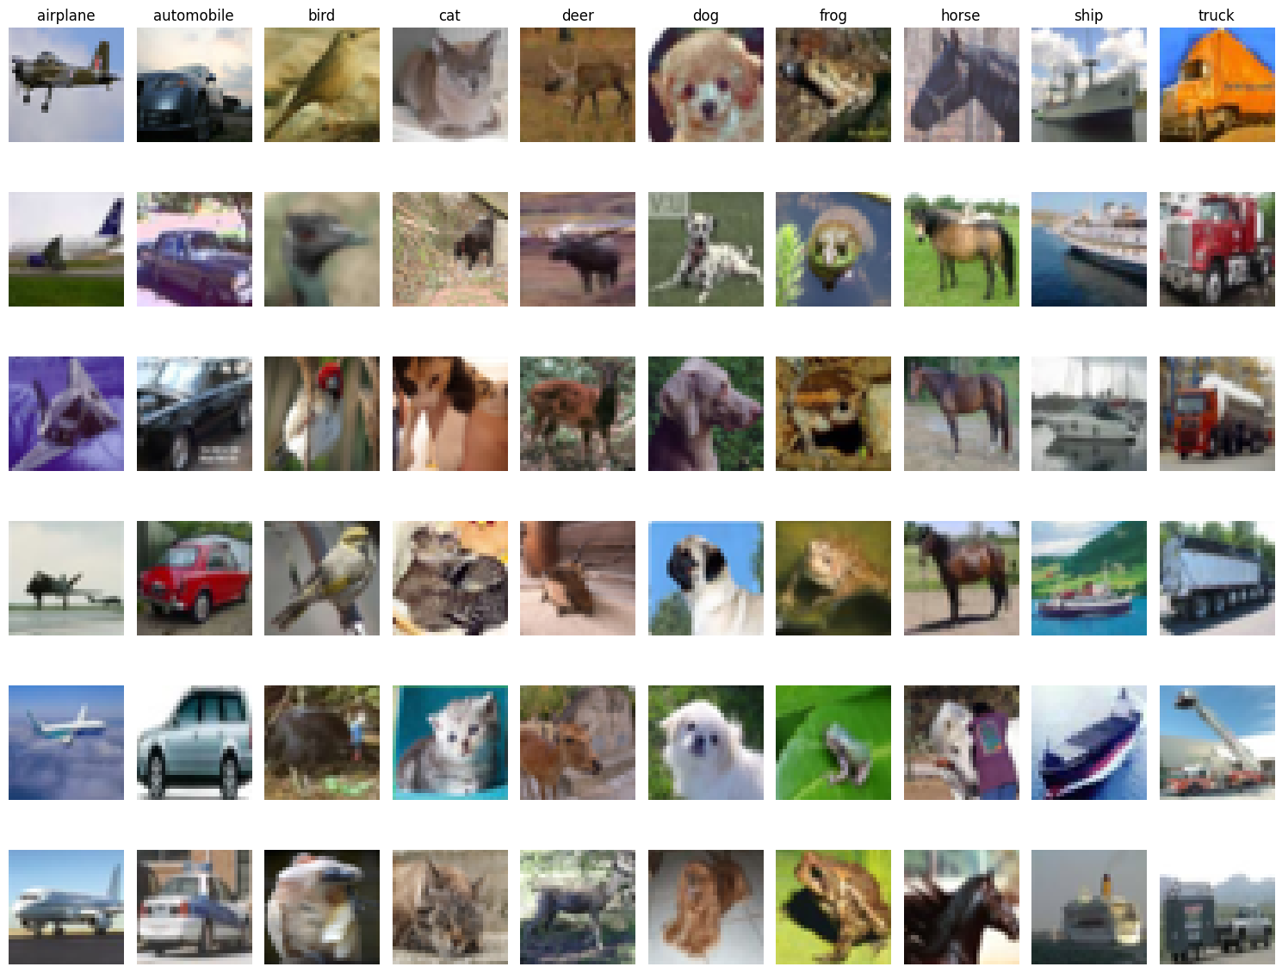
Dataset Description
We utilize the CIFAR-10 dataset, a benchmark in machine learning and computer vision. CIFAR-10 consists of 60,000 32x32 color images across 10 classes (airplane, automobile, bird, cat, deer, dog, frog, horse, ship, truck), split into 50,000 training and 10,000 test images.

Slide 3
Data Loading
Data is divided into batches, so we need to put them together handling them properly.
X_train
ciao
ciao
ciao
ciao
ciao
ciao
ciao
ciao
ciao
ciao
ciao
ciao
ciao
ciao
ciao
ciao
ciao
ciao
ciao
ciao
ciao
ciao
ciao
ciao
ciao
ciao
ciao
ciao
ciao
ciao
ciao
ciao
ciao
ciao
ciao
ciao
ciao
ciao
ciao
ciao
ciao
ciao
ciao
ciao
ciao
ciao
ciao
ciao
ciao
ciao
ciao
ciao
ciao
ciao
ciao
ciao
ciao
ciao
ciao
ciao
ciao
ciao
ciao
ciao
ciao
ciao
ciao
ciao
ciao
ciao
ciao
ciao
ciao
ciao
ciao
ciao
ciao
ciao
ciao
ciao
ciao
ciao
ciao
ciao
ciao
ciao
ciao
ciao
ciao
ciao
ciao
ciao
ciao
…
test_batch data_batch_3 data_batch_2 data_batch_5 data_batch_1 data_batch_4 batches.meta readme.html
shape: (45000, 32, 32, 3)
y_train
…
label_i
label_i
label_i
label_i
label_i
label_i
label_i
label_i
label_i
label_i
label_i
label_i
label_i
label_i
label_i
label_i
label_i
label_i
label_i
label_i
label_i
label_i
label_i
label_i
label_i
label_i
label_i
label_i
label_i
label_i
label_i
label_i
label_i
label_i
label_i
shape: (45000, 1)
X_test
X_val
ciao
ciao
ciao
ciao
ciao
ciao
ciao
ciao
ciao
ciao
ciao
ciao
ciao
ciao
ciao
ciao
ciao
ciao
ciao
ciao
ciao
ciao
ciao
ciao
ciao
ciao
ciao
ciao
ciao
ciao
ciao
ciao
ciao
ciao
ciao
ciao
ciao
ciao
ciao
ciao
ciao
ciao
ciao
ciao
ciao
ciao
ciao
ciao
ciao
ciao
ciao
ciao
ciao
ciao
ciao
ciao
ciao
ciao
ciao
ciao
ciao
ciao
ciao
ciao
ciao
ciao
ciao
ciao
ciao
ciao
ciao
ciao
…
…
shape: (10000, 32, 32, 3)
shape: (5000, 32, 32, 3)
y_test
y_val
…
…
label_i
label_i
label_i
label_i
label_i
label_i
label_i
label_i
label_i
label_i
label_i
label_i
label_i
label_i
label_i
label_i
label_i
label_i
label_i
label_i
label_i
label_i
shape: (10000, 1)
shape: (5000, 1)

Slide 4
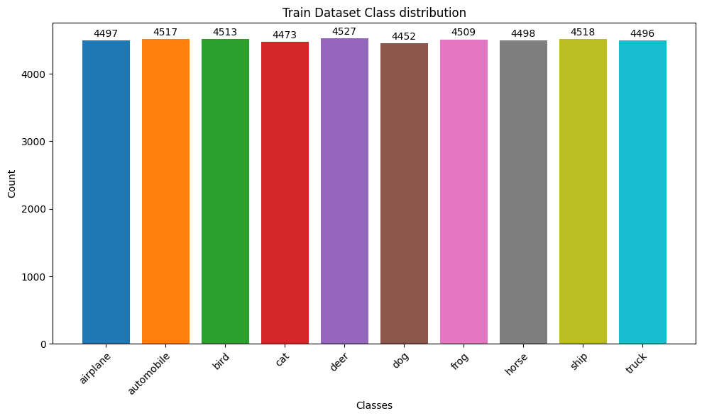
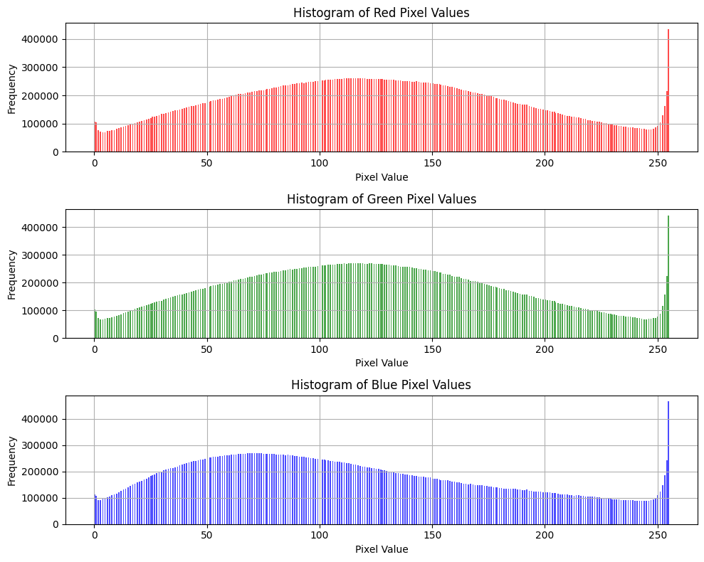

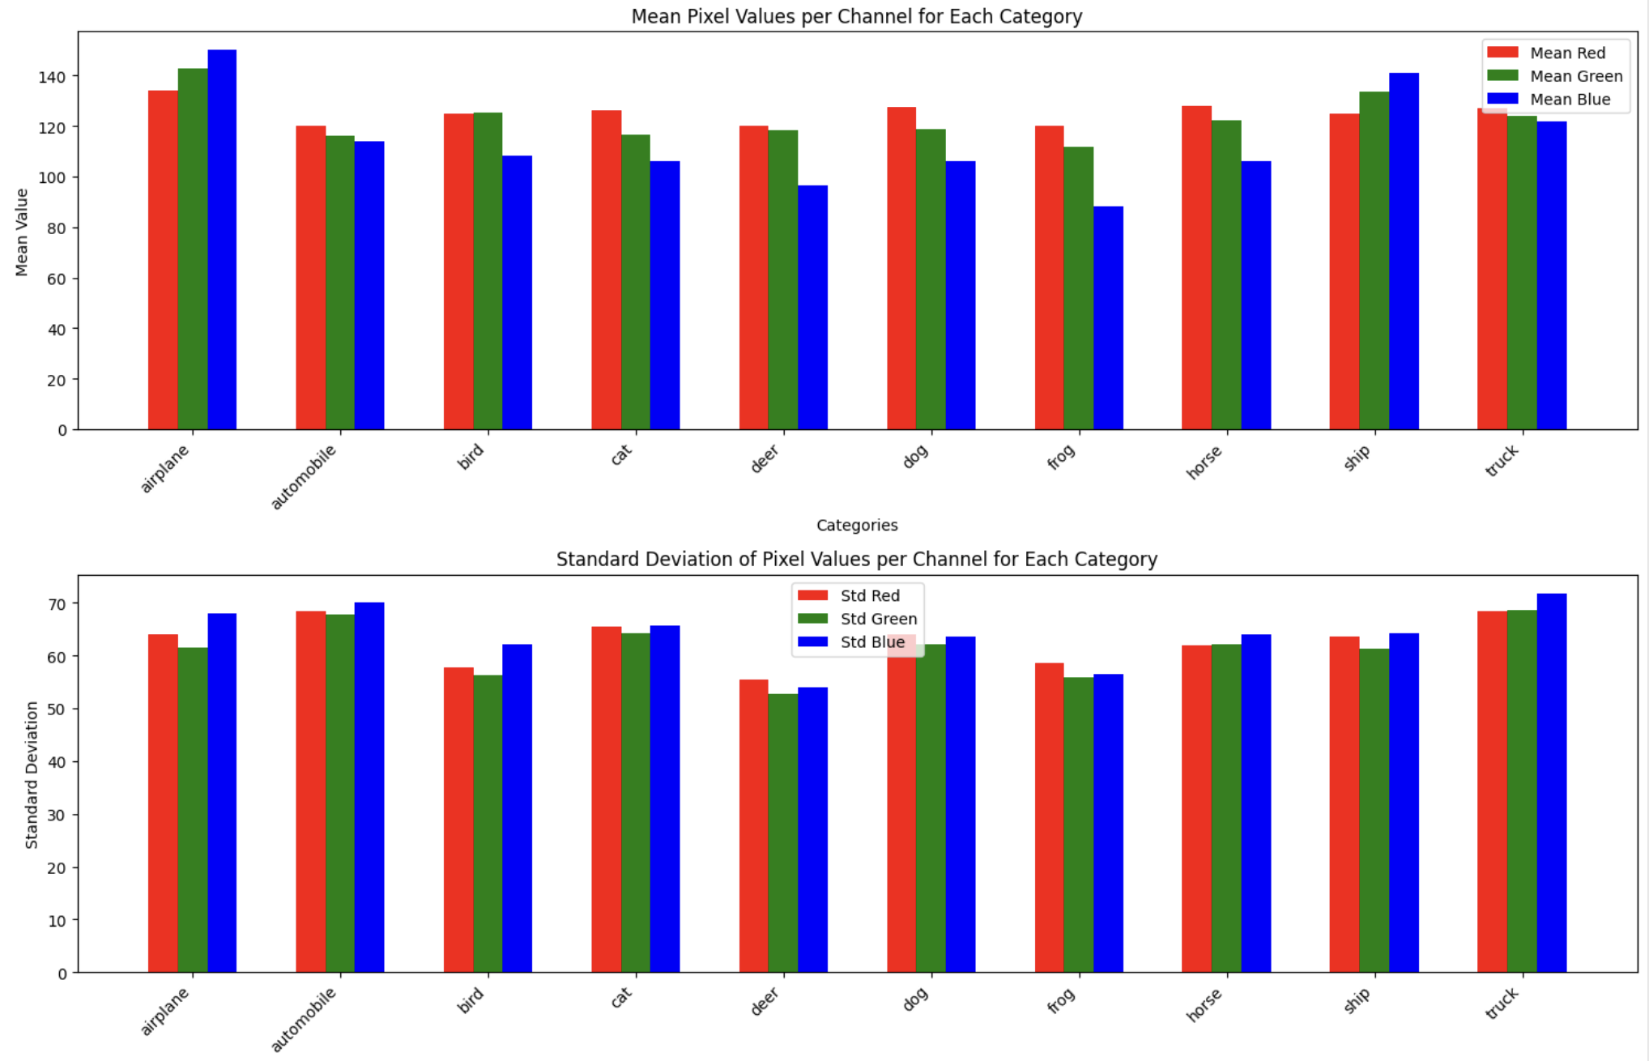
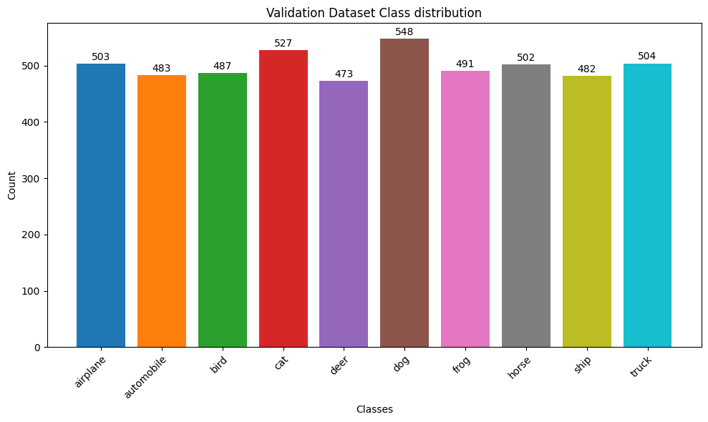
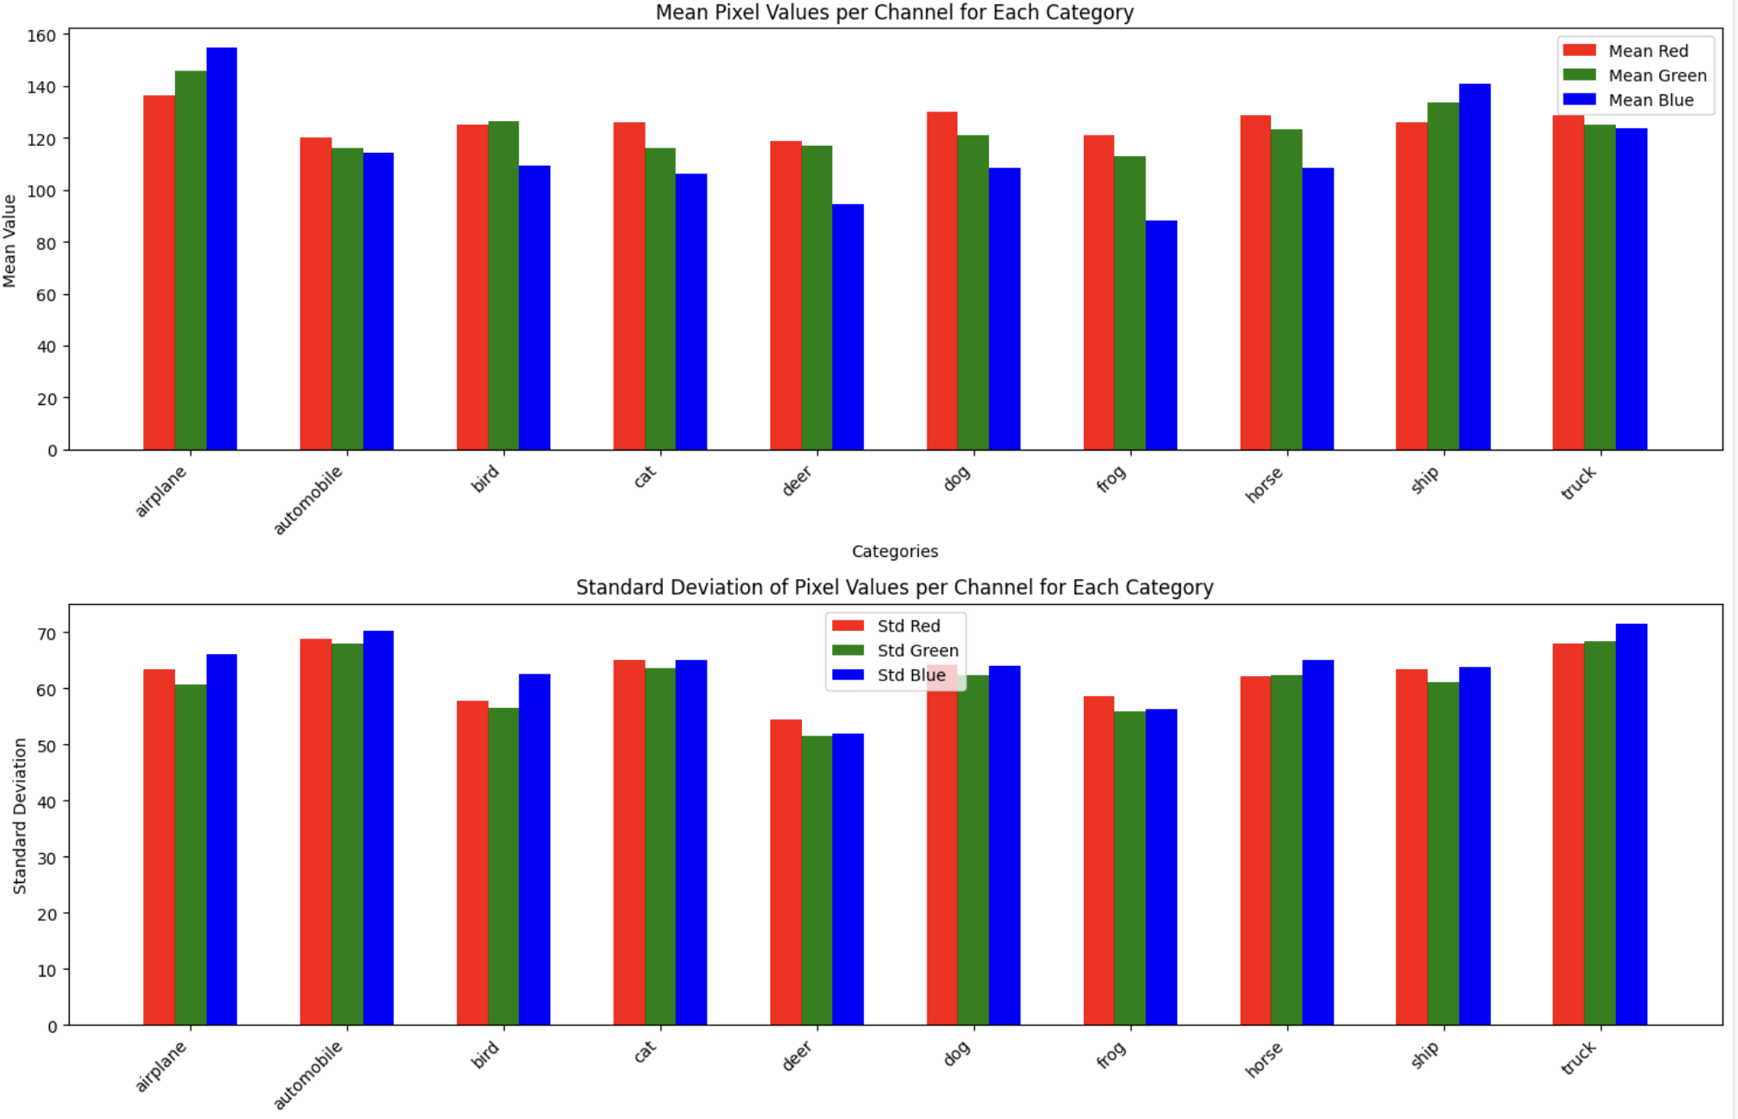
Data Exploration
Data Preprocessing – Standardize Images
Counting the occurrences of each class in train, test, and validation datasets, and examining pixel intensity distributions to ensure data consistency and quality.
Preparing images for deep learning models by ensuring consistent scale, mean, and variance across all data points.
Before:
X_train → min value: 0, max value: 255
X_val → min value: 0, max value: 255
X_test → min value: 0, max value: 255
Class Distribution
Pixel Value Distribution
After:
X_train → min value: -1.8818130406147902, max value: 2.092982848500095
X_val→ min value: -1.8818130406147902, max value: 2.092982848500095
X_test → min value: -1.8818130406147902, max value: 2.092982848500095
One Hot Encoding
Before:
y_train.shape → (45000, 10)
y_val.shape→ (5000, 10)
y_test.shape → (10000, 10)
After:
y_train[0] → array([0., 0., 1., 0., 0., 0., 0., 0., 0., 0.], dtype=float32)
y_val[0] → array([0., 0., 0., 0., 0., 1., 0., 0., 0., 0.], dtype=float32)
y_test[0] → array([0., 0., 0., 0., 0., 0., 0., 0., 1., 0.], dtype=float32)

Slide 5
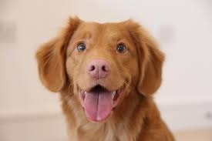
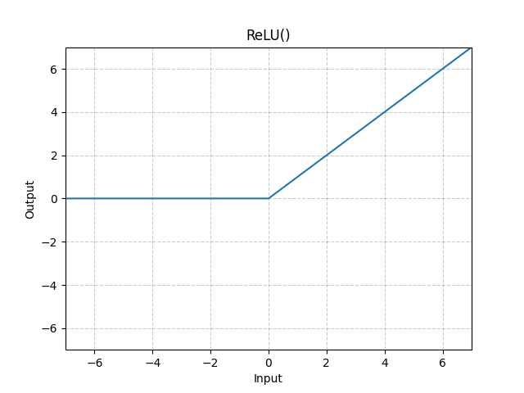
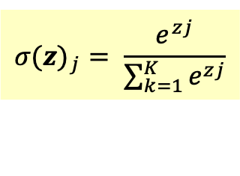
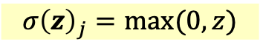
CNN1 - Basic CNN – Model definition
$${σ\left(z\right)}_{j}=max⁡(0,z)$$
This architecture consists in a simple Convolutional Neural Network with three convolutional blocks, each with a convolutional layer with increasing number of filters [32, 64, 128], followed by ReLU activation and max pooling, culminating in a global max pooling layer and two dense layers with 64 neurons the first and 10 (num_classes) the last. The final one uses softmax activation for classification.
1
airplane
1
2
automobile
ciao
2
3
bird
ciao
ciao
3
4
cat
4
5
deer
Second Convolutional Block
First Convolutional Block
Third Convolutional Block
. . .
6
dog
7
frog
4x4x128
62
32x32x32
11x11x64
11x11x32
4x4x64
32x32x3
63
8
horse
128
64
9
ship
Global
MaxPooling2D
MaxPooling2D
Conv2D
Conv2D
Conv2D
MaxPooling2D
$${σ(z)}_{j}= \frac{e^{zj}}{\sum_{k=1}^{K}{e^{zj}}}$$
10
truck

Slide 6
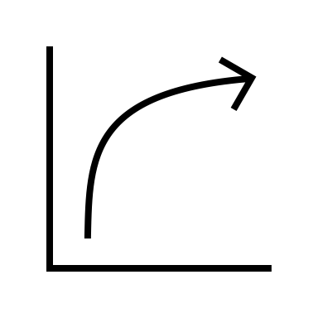


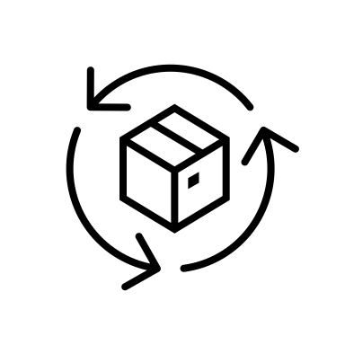

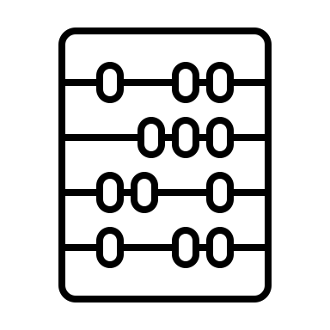



CNN1 - Basic CNN – Parameters and Callbacks
Hyperparameters
Optimizer, loss and metrics
Callbacks
0,001
Adam
ModelCheckpoint
40
Crossentropy
BackupAndRestore
64
Accuracy
CSVLogger

Slide 7
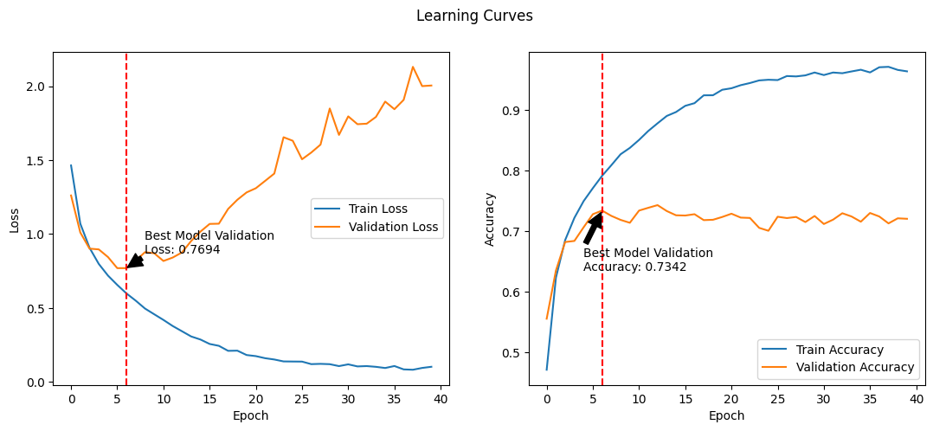
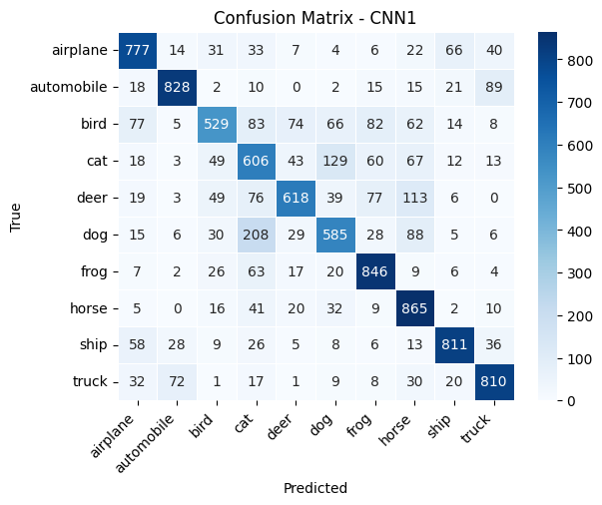
CNN1 - Basic CNN – Results
Learning Curves
Evaluation
CNN1 accuracy on test data: 72.75%

Slide 8

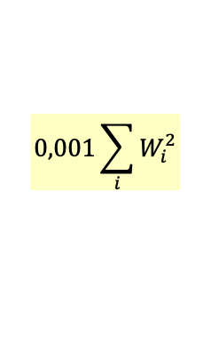

CNN2 - Improved CNN - Model definition
$${σ\left(z\right)}_{j}=max⁡(0,z)$$
This architecture enhances the initial model by incorporating several improvements in order to achieve better performance and reduce overfitting. It consists of four convolutional blocks, each with a convolutional layer that has an increasing number of filters [32, 64, 128, 256], kernel regularizer (L2), batch normalization, ReLU activation, max pooling layers with a pool size of (2, 2), dropout layers, two dense layers, with 128 and 64 neurons respectively, each followed by a 0.5 dropout for regularization. The final dense layer has 10 (num_classes) neurons with softmax activation for classification.
$$0,001\sum_{i}{W_{i}^{2}}$$
1
airplane
1
1
2
automobile
2
2
3
bird
ciao
3
3
4
cat
ciao
ciao
ciao
4
1
4
1
5
deer
. . .
. . .
6
dog
0,5
0,5
Third Convolutional Block
First Convolutional Block
Second Convolutional Block
7
frog
Fourth Convolutional Block
126
62
32x32x32
16x16x64
16x16x32
8x8x128
4x4x256
4x4x128
8
8x8x64
127
63
horse
64
9
ship
128
256
L2
1
1
1
L2
0,7
L2
0,7
L2
0,7
$${σ(z)}_{j}= \frac{e^{zj}}{\sum_{k=1}^{K}{e^{zj}}}$$
10
truck
Conv2D
Batch
Normalization
Max
Pooling2D
Dropout
Max
Pooling2D
Dropout
Max
Pooling2D
Dropout
Global
MaxPooling2D
Conv2D
Batch
Normalization
Conv2D
Batch
Normalization
Conv2D
Batch
Normalization

Slide 9
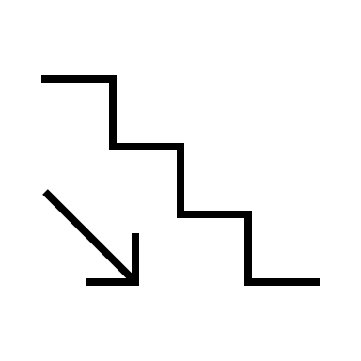

CNN2 - Improved CNN - Parameters and Callbacks
Hyperparameters
Optimizer, loss and metrics
Callbacks
ReduceLROnPlateau
0,001
Adam
EarlyStopping
100
Crossentropy
ModelCheckpoint
BackupAndRestore
64
Accuracy
CSVLogger

Slide 10
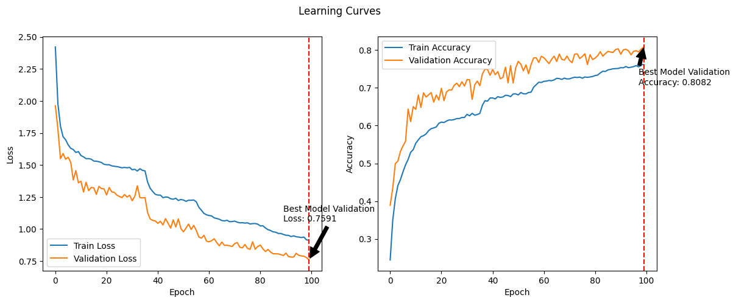
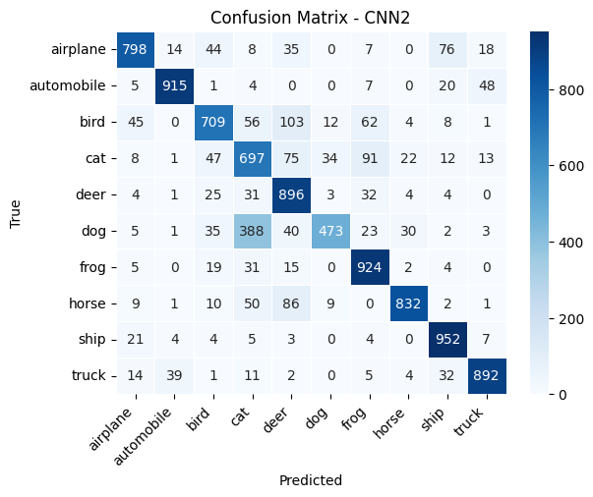
CNN2 - Improved CNN - Results
Learning Curves
Evaluation
CNN2 accuracy on test data: 80.88%

Slide 11
Residual Network - Definition
$${σ\left(z\right)}_{j}=max⁡(0,z)$$
This architecture leads to relevant improvements with respect to previous models by incorporating Residual Blocks, which help in training deeper networks effectively by mitigating the vanishing gradient problem.
$$0,001\sum_{i}{W_{i}^{2}}$$
1
airplane
1
1
2
automobile
conv_shortcut = FALSE
conv_shortcut = TRUE
conv_shortcut = FALSE
conv_shortcut = FALSE
conv_shortcut = FALSE
conv_shortcut = TRUE
conv_shortcut = TRUE
conv_shortcut = FALSE
2
2
3
bird
ciao
3
3
4
cat
ciao
ciao
ciao
ciao
ciao
ciao
ciao
ciao
4
1
4
1
5
deer
. . .
. . .
6
dog
First Convolutional Layer
GlobalMaxPooling2D
0,4
0,4
Residual Block
Residual Block
MaxPooling2D
Residual Block
MaxPooling2D
MaxPooling2D
Residual Block
Residual Block
Residual Block
Residual Block
Residual Block
7
frog
126
62
63
8
horse
filters = 32
filters = 64
127
filters = 32
filters = 64
64
9
ship
128
Conv2D(32, (3, 3), padding='same', l2(0.001))
BatchNormalization()
Activation('relu')
$${σ(z)}_{j}= \frac{e^{zj}}{\sum_{k=1}^{K}{e^{zj}}}$$
10
truck

Slide 12

Residual Network – Residual Block
Conv2
BatchNormalization
32x32x32
TRUE
If conv_shortcut
FALSE
Conv2
Conv2
BatchNormalization
BatchNormalization

Slide 13
Residual Network – Parameters and Callbacks
Hyperparameters
Optimizer, loss and metrics
Callbacks
ReduceLROnPlateau
0,001
Adam
EarlyStopping
100
Crossentropy
ModelCheckpoint
BackupAndRestore
64
Accuracy
CSVLogger

Slide 14
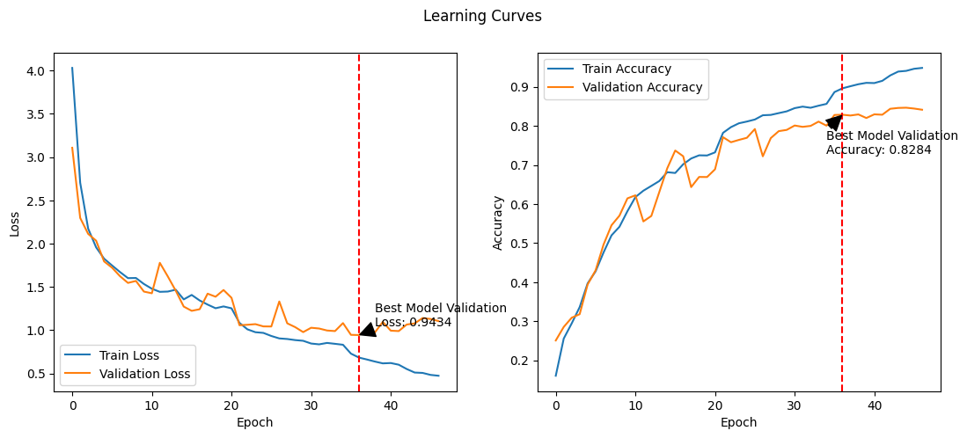
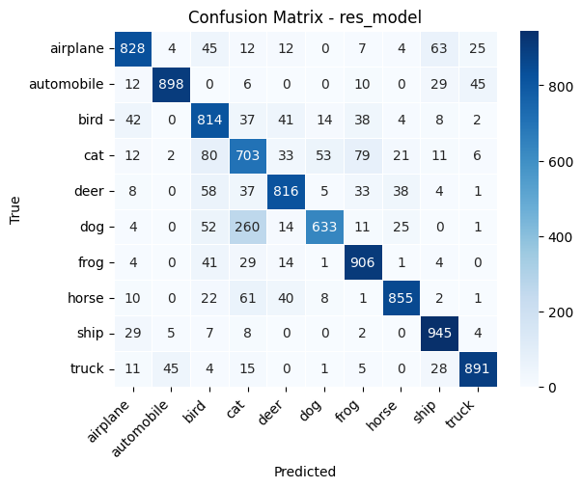
Residual Network – Results
Learning Curves
Evaluation
res_model accuracy on test data: 82.89%

Slide 15
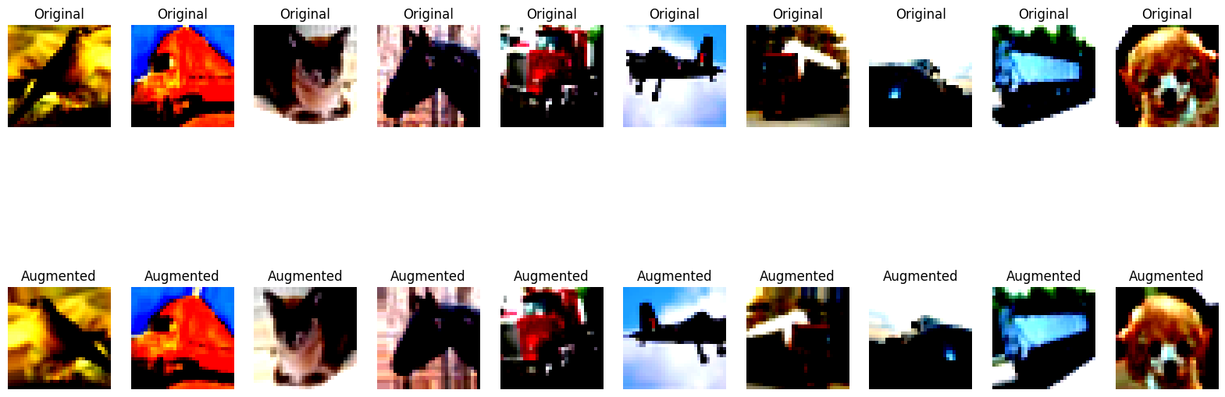
Residual Network – Data Augmentation

Slide 16
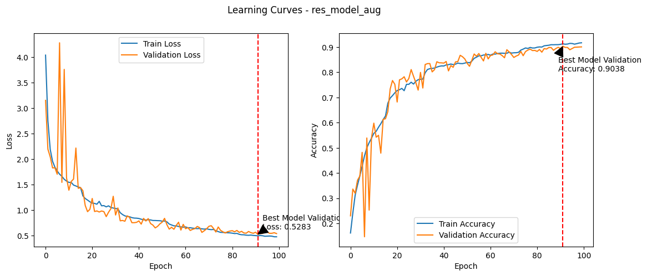
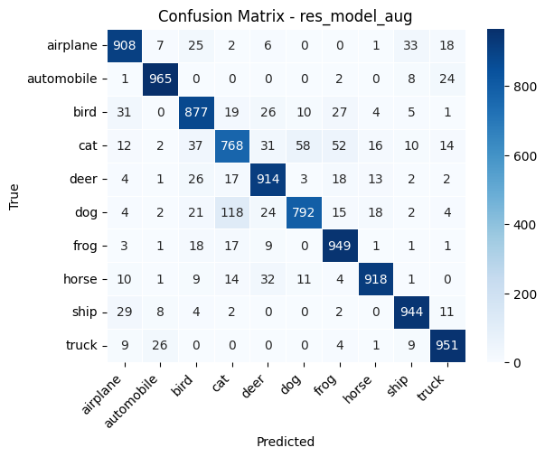


Residual Network – Data Augmentation – Results
Learning Curves
Evaluation
res_model_aug accuracy on test data: 89.86%

Slide 17

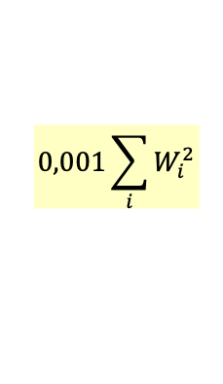
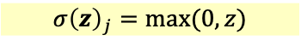
ResNet50v2– Transfer Learning - Definition
$${σ\left(z\right)}_{j}=max⁡(0,z)$$
$$0,001\sum_{i}{W_{i}^{2}}$$
1
airplane
1
1
2
automobile
ciao
ciao
zero-centering
2
2
3
bird
3
3
4
cat
PreProcess Input
1
1
1
GlobalAveragePooling2D
4
4
5
deer
0,7
. . .
0,7
. . .
0,8
6
dog
7
frog
1022
510
UpSampling2D (7,7)
8
horse
1023
511
ResNet50V2
9
1024
512
ship
include_top=False
weights="imagenet"
input_shape=(224, 224, 3)
$${σ(z)}_{j}= \frac{e^{zj}}{\sum_{k=1}^{K}{e^{zj}}}$$
10
truck

Slide 18
ResNet50v2– Transfer Learning - Parameters and Callbacks
Hyperparameters
Optimizer, loss and metrics
Callbacks
ReduceLROnPlateau
0,001
Adam
EarlyStopping
100
Crossentropy
ModelCheckpoint
BackupAndRestore
64
Accuracy
CSVLogger

Slide 19
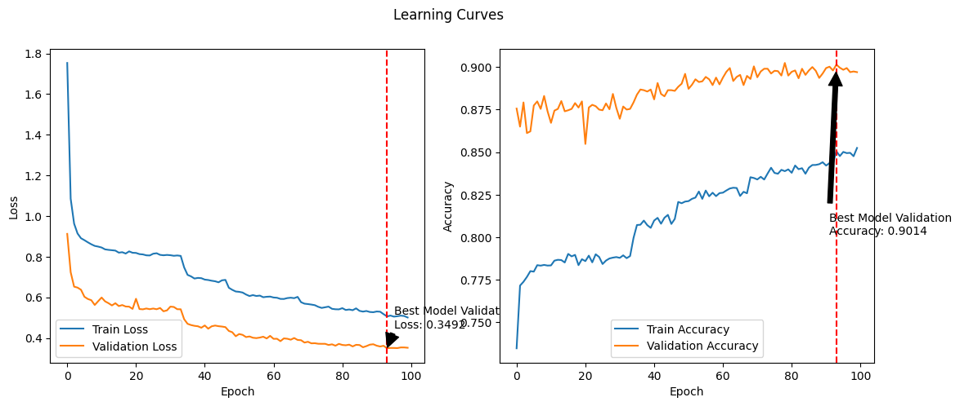
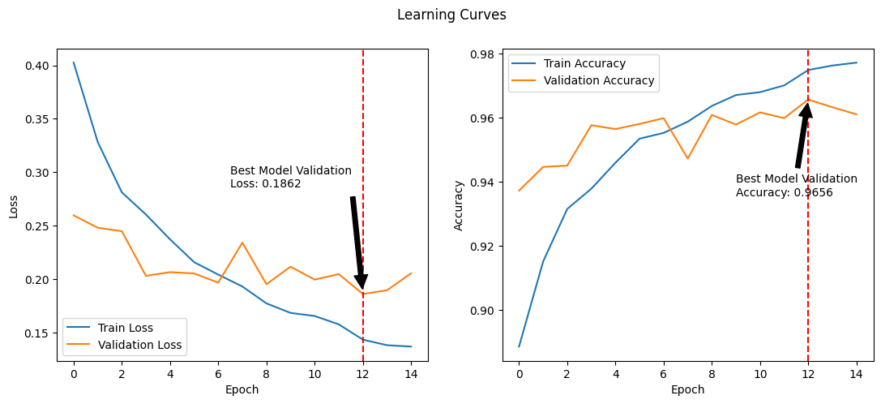


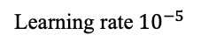


ResNet50v2– Transfer Learning – Data Augmentation - Results
Learning Curves
Learning Curves
+ Fine Tuning
Learning rate${10}^{−5}$
Evaluation
EfficientNetV2S accuracy on test data: 96.35%

Slide 20
tl_EfficientNetV2S – Transfer Learning - Definition
$${σ\left(z\right)}_{j}=max⁡(0,z)$$
$$0,001\sum_{i}{W_{i}^{2}}$$
1
airplane
1
1
2
automobile
ciao
ciao
[0,255] -> [-1,1]
2
2
3
bird
3
3
4
cat
PreProcess Input
1
1
1
GlobalAveragePooling2D
4
4
5
deer
0,7
. . .
0,7
. . .
0,8
6
dog
7
frog
1022
510
Resize(inputs, (128, 128))
8
horse
1023
511
EfficientNetV2S
9
1024
512
ship
include_top=False
weights="imagenet"
input_shape=(128, 128, 3)
$${σ(z)}_{j}= \frac{e^{zj}}{\sum_{k=1}^{K}{e^{zj}}}$$
10
truck

Slide 21
EfficientNetV2S– Transfer Learning - Parameters and Callbacks
Hyperparameters
Optimizer, loss and metrics
Callbacks
ReduceLROnPlateau
0,001
Adam
EarlyStopping
100
Crossentropy
ModelCheckpoint
BackupAndRestore
64
Accuracy
CSVLogger

Slide 22
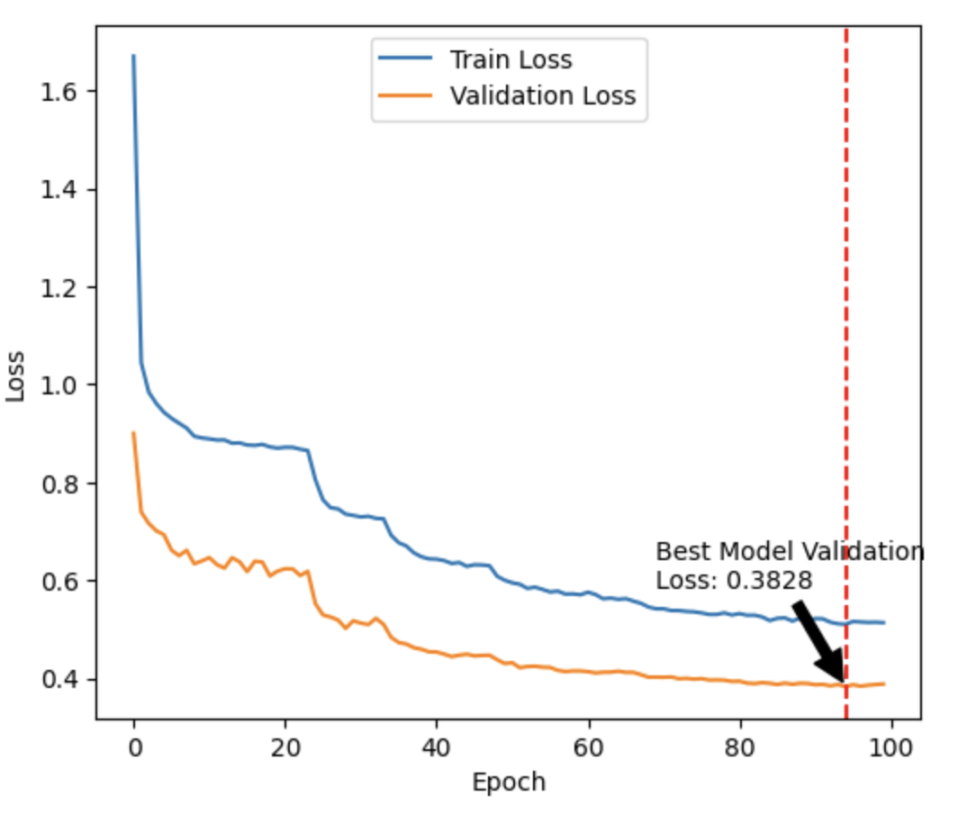
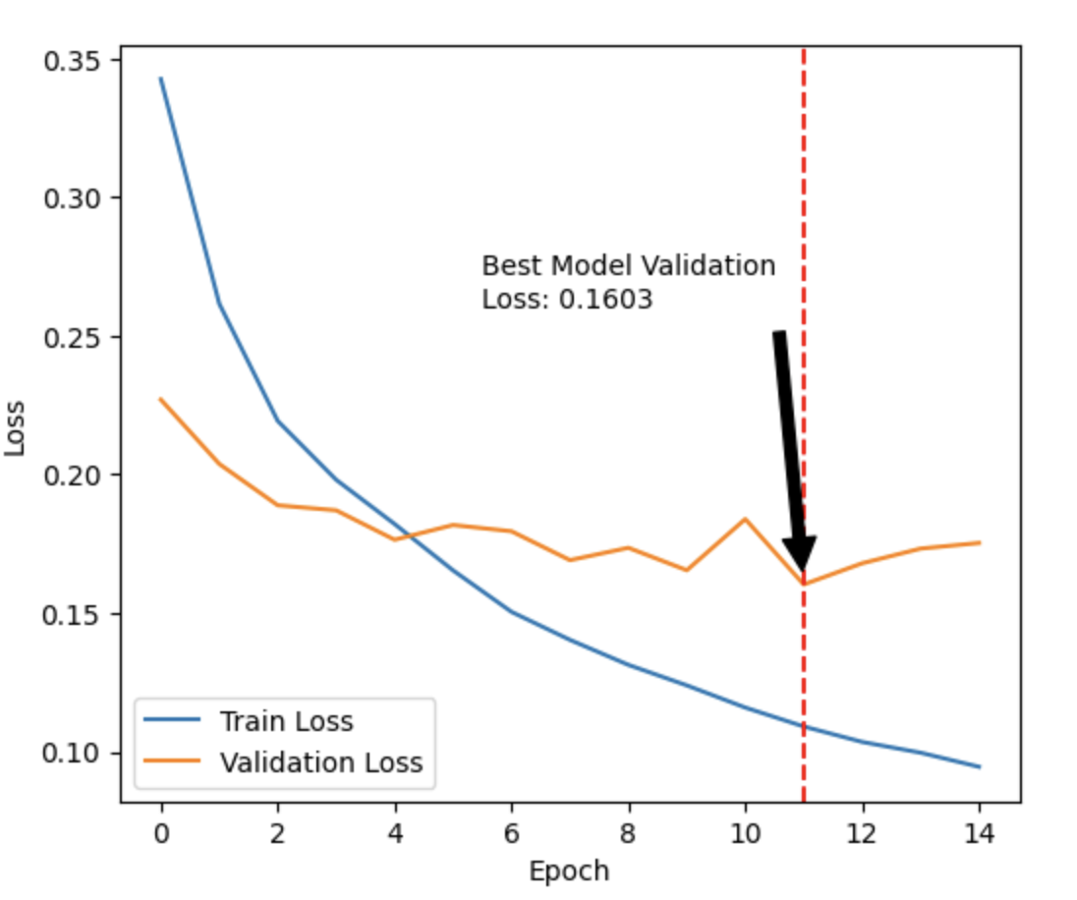
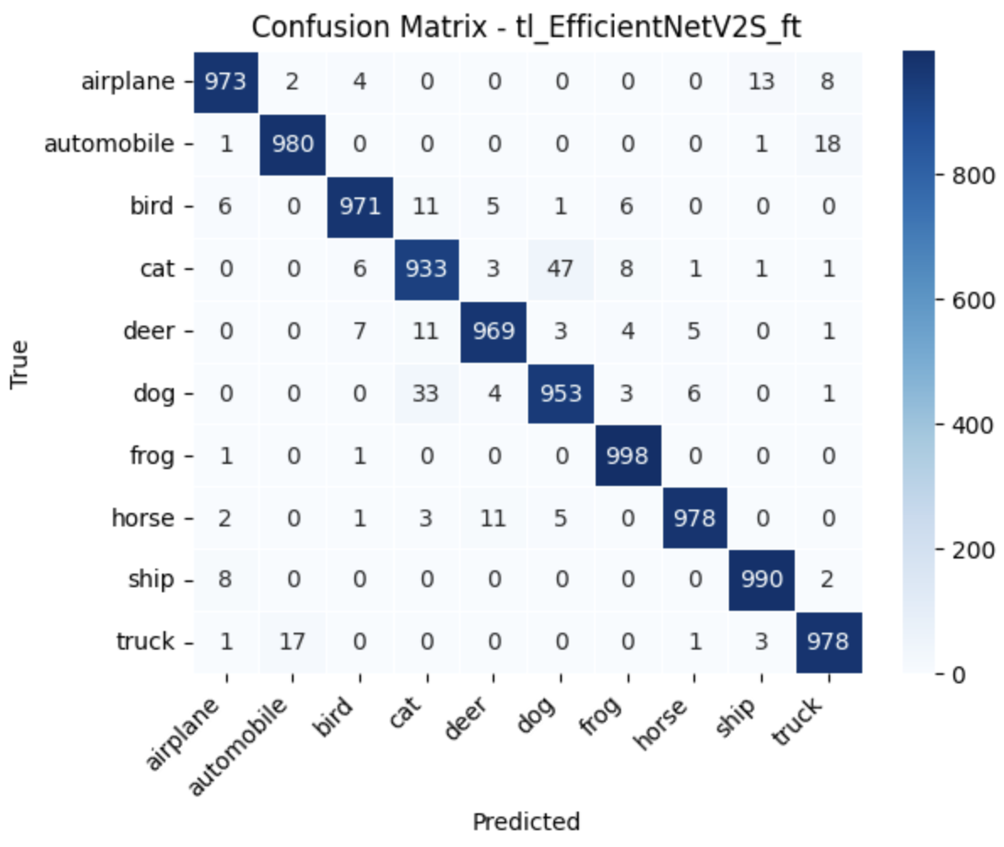
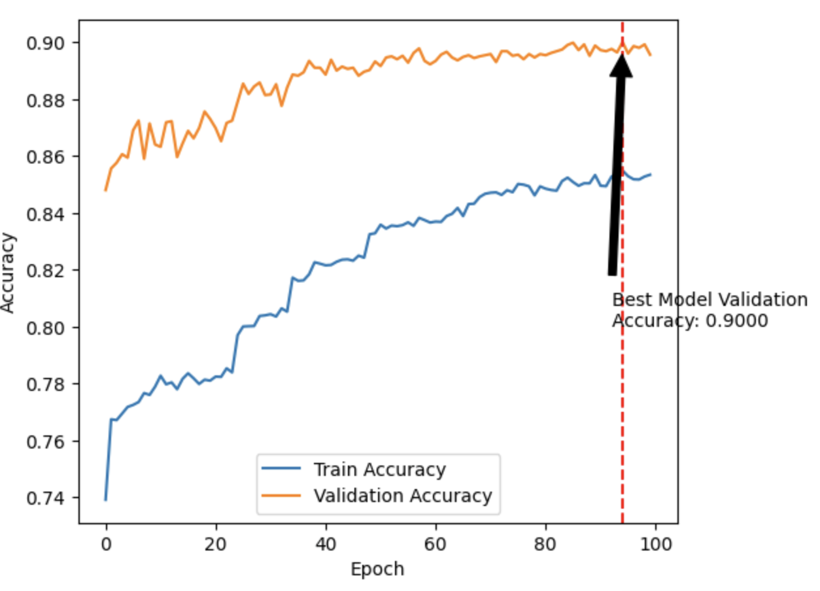
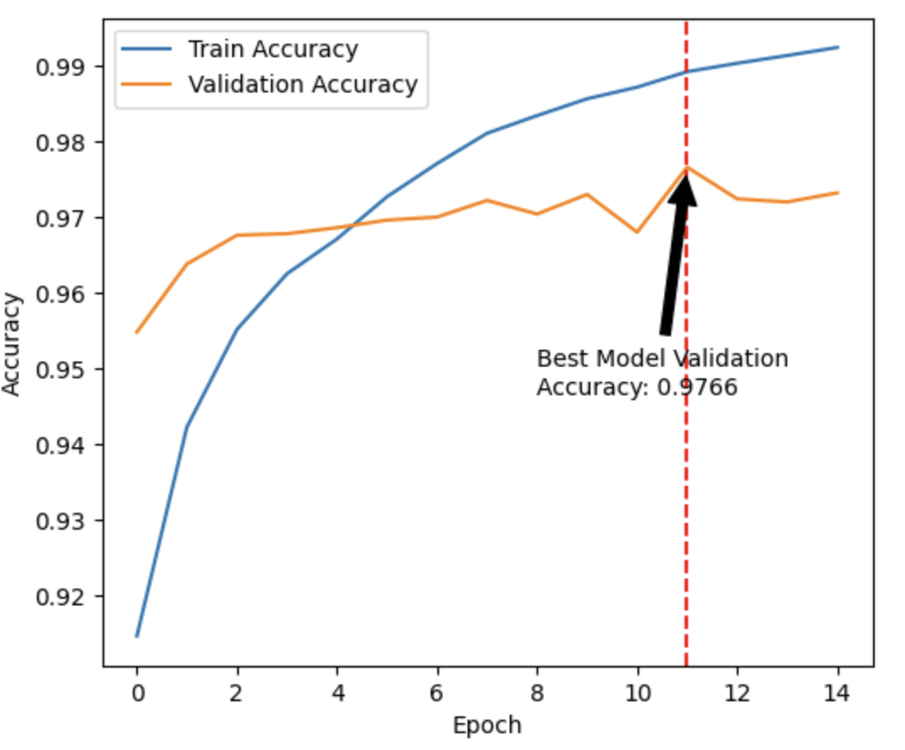


EfficientNetV2S– Transfer Learning – Data Augmentation - Results
Learning Curves
Learning Curves
+ Fine Tuning
Learning rate${10}^{−5}$
Evaluation
tl_ResNet50v2 accuracy on test data: 97,23%

Slide 23
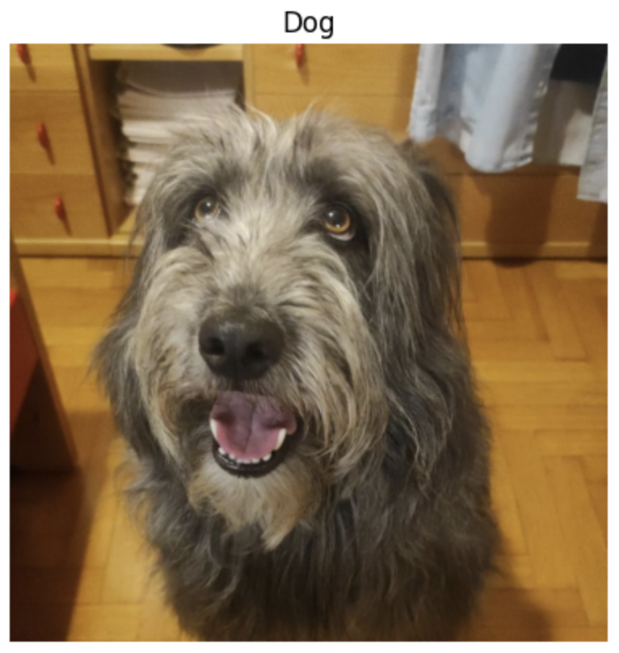
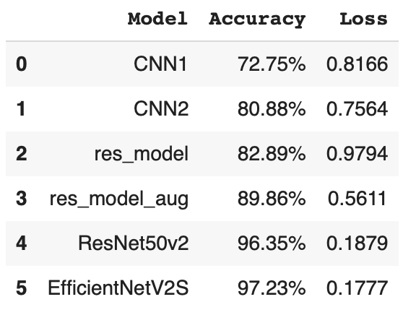
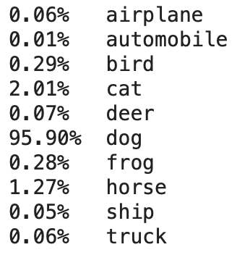
Conclusions
Example image

